Slide 1
Recognition types and policies Higher education reforms in Europe–
Ramina Baiba
Academic Information Centre
Director
1 March 2017

Slide 2
Political frame for recognition
Lisbon Recognition Convention
Bologna process
Qualification framework
EC recommendations
(Qualification Framework, validation of non-formal/in-formal learning
EU directives
(Regulated professions)

Slide 3
Types of recognition
Academic recognition | De jure professional recognition | De facto professional recognition
Diploma holder would like to continue studies Diploma holder would like to work in profession, which requests certain level of education | For access to regulated professions | For access to the non-regulated parts of the labour market

Slide 4
Recognition of qualifications
Old approaches:
Today:
Nostrification – the foreign qualification is identical to the one it is compared with
Equivalence – the foreign qualification can replace the home prototype in all aspects
Recognition – the foreign qualification has no substantial differences with regard to the purpose for which it is going to be used
In Europe, academic and professional recognition is usually separated
Lisbon Recognition Convention covers academic recognition and “academic recognition for professional purposes”
EU directive(s) on professional recognition cover regulated professions

Slide 5
Professional recognition in regulated professions Purpose of Directive 2005/36/EC
Establishes rules according to which a Member State which makes access to or pursuit of a regulated profession in its territory asking specific professional qualifications shall recognize professional qualifications obtained in one or more other Member States and which allow the holder of the said qualifications to pursue the same profession there, for access to and pursuit of that profession.

Slide 6
Regulated professions
Definition in directive 36/2005 | Free definition
Regulated profession: a professional activity or group of professional activities, access to which, the pursuit of which, or one of the modes of pursuit of which is subject, directly or indirectly, by virtue of legislative, regulatory or administrative provisions to the possession of specific professional qualifications; in particular, the use of a professional title limited by legislative, regulatory or administrative provisions to holders of a given professional qualification shall constitute a mode of pursuit | Regulated profession: a profession to be employed (practise) in it person need definite type of education or evidence of professional qualification

Slide 7
Regulated professions in Latvia (69)
Transport | Health care | Others
Driver of power-driven vehicle Driver of a vehicle carrying dangerous goods by road Engine driver – instructor Engine driver (machinist) Engine – driver`s assistant Master (of the ship) Ship`s engineer Sailor Radio specialist(in maritime) Pilot Flight navigator Pilot radiotelephone operator Cockpit flight engineer Air traffic controller Civil aviation security inspector Aircraft technical maintenance specialist Consultant of dangerous goods transportation | Medical Doctor Dentist Pharmacist Nurse of general care Midwife Doctor assistant Pharmacist`s assistant Laboratory assistant Dental technician Dental hygienist Physiotherapist Ergo therapist Optometrist; Physiotherapist`s assistant Ergo therapist’s assistant Hippo therapist Hippo therapist`s assistant Technical orthopaedist Cosmetician Dentist assistant Nurse in dentistry Speech therapist Radiologist`s assistant Nutrition specialist | Architect Construction work manager Construction technician Veterinarian Teacher Sport specialists Electrical engineer Electric mounter Electro technician Advocate Sworn auditor Sworn land surveyor Estate surveyor Welder of metallic materials Defectoskopist Tourist guide Detective Security officer

Slide 8
Dental practitioners (example from directive 36/2005/EC)
Basic dental training
Admission requirement: certificate giving rights to study in university,
At least 5 years full time theoretical and practical studies covering at least programme in annex 5.3.1
Specialist dental training
Admission requirement: 5 years studies in dentistry should be completed
Placement: university or medical teaching hospital, or health establishment
Length: not less than 3 years

Slide 9
Bologna process
Where was Europe before Bologna
Just a few systems had a long tradition of Bachelor-Master structure
Some countries had just introduced Bachelor -Master structure
In many continental European countries the typical HE final qualification was awarded after 4-6 years long one-tier programs,
In some countries: several sequential HE qualifications with different functions but it was difficult to indicate the bachelor and master levels in the present understanding

Slide 10
Bologna declaration
Set out a vision of an internationally competitive and attractive European Higher Education
promote citizens' mobility
promote citizens' employability
increase the international competitiveness of the European higher education
Bologna declaration signed on 19 June 1999 29 countries started, rest joined later, now 48 countries

Slide 11
Main Bologna declaration action lines (I)
Adoption of a system of easily readable and comparable degrees based on three cycles, where already the 1st cycle graduates are employable in the European labor market
Promotion of student & staff mobility
Establishment of a system of credits for transfer & accummulation
Introducing qualifications frameworks
Promotion of European co-operation in quality assurance
Student-centred learning
Lifelong learning
Promoting cooperation of European Higher Education Area with other parts of the World
Social dimension

Slide 12
Bologna tools for recognition
3 cycle system – bachelor, master and doctor
Short cycle as part of first cycle
Diploma supplement
European credit transfer and accumulation system
Learning outcomes

Slide 13
ECTS – European credit transfer and accumulation system
Initially established under the Erasmus programme (1988-1995)
Based on student workload and learning outcomes: A certain number of credits is awarded on condition that the planned learning outcomes have been achieved
ECTS users guide 2015 http://ec.europa.eu/dgs/education_culture/repository/education/library/publications/2015/ects-users-guide_en.pdf
Measure: 60 ECTS credits correspond to workload of full-time study year

Slide 14
Diploma Supplement
Main aim – to enhance recognition and mobility
It is not a substitute of the original qualification or diploma
One of the transparency instruments in higher education
It is not automatic system that guarantees recognition

Slide 15
8 sections of Diploma Supplement
Information identifying the holder of qualification
Information identifying the qualification
Information on the level of qualification
Information on the contents and results gained
Information on the function of the qualification
Additional information
Certification of the supplement
Information on the national higher education system

Slide 16
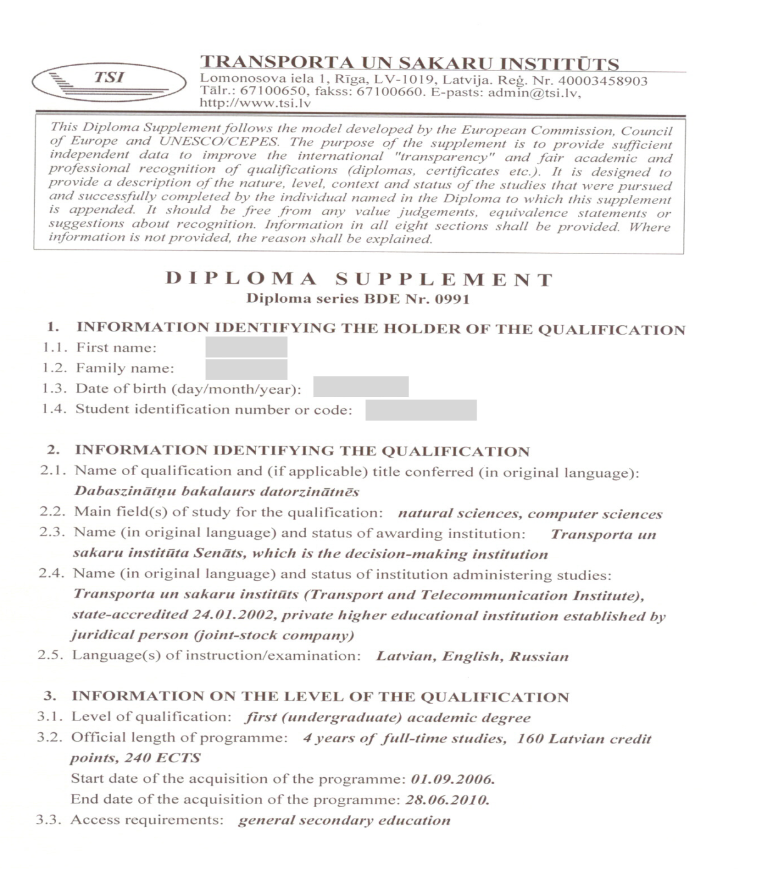
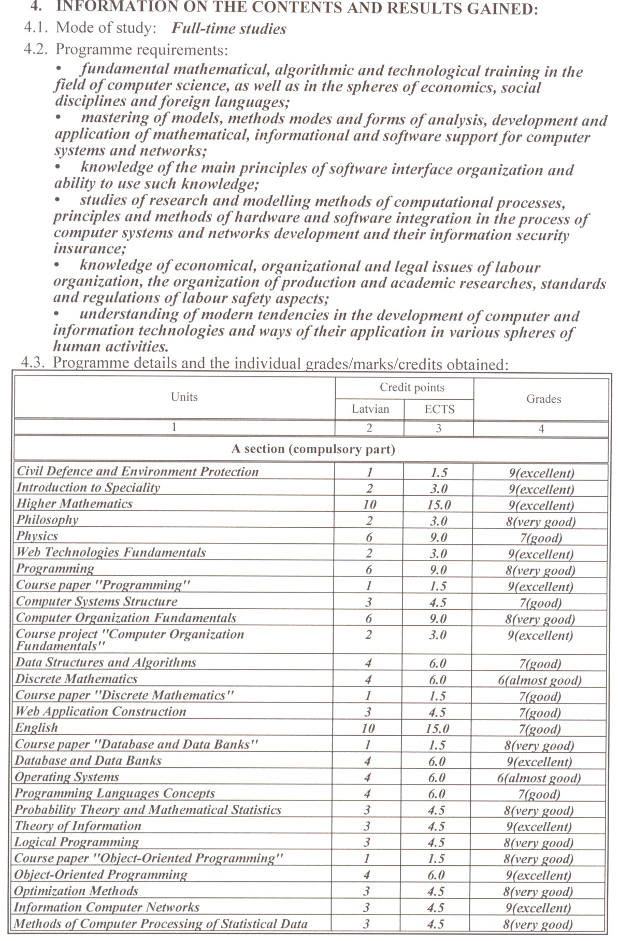

Slide 17
Framework of qualifications for the European Higher Education Area
Bergen Communiqué 2005
Adopted the overarching framework for qualifications in the EHEA, comprising three cycles
Included generic descriptors for each cycle based on learning outcomes and competences
Initiated elaborating national frameworks for qualifications compatible with the overarching framework for qualifications in the EHEA by 2010

Slide 18
Overarching qualifications framework for the European Higher Education Area
Cycles:
Short cycle: approx. 120 ECTS
First cycle: 180-240 ECTS
Second cycle: 90-120 ECTS (min 60)
Third cycle: not specified
Cycles based on generic descriptors (the Dublin descriptors, today also on EQF descriptors)
Knowledge and understanding
Applying knowledge and understanding
Making judgments
Communication skills
Learning skills

Slide 20
Thank you for attention!
Contact Information Phone: (+371) 67 225 155 E-mail: aic@aic.lv

